Slide 1
Nimshi Dishali Palihawadana
1722856
Customized Web Based Software For Customer Handling At L.N.D. Graphics (PVT) Ltd.
Undergraduate Project
BSc (Hons) Computer Science and Software Engineering
Department of Computer Science & Technology
University of Bedfordshire
Supervisor: Ms. Dilushinie Fernando

Slide 2
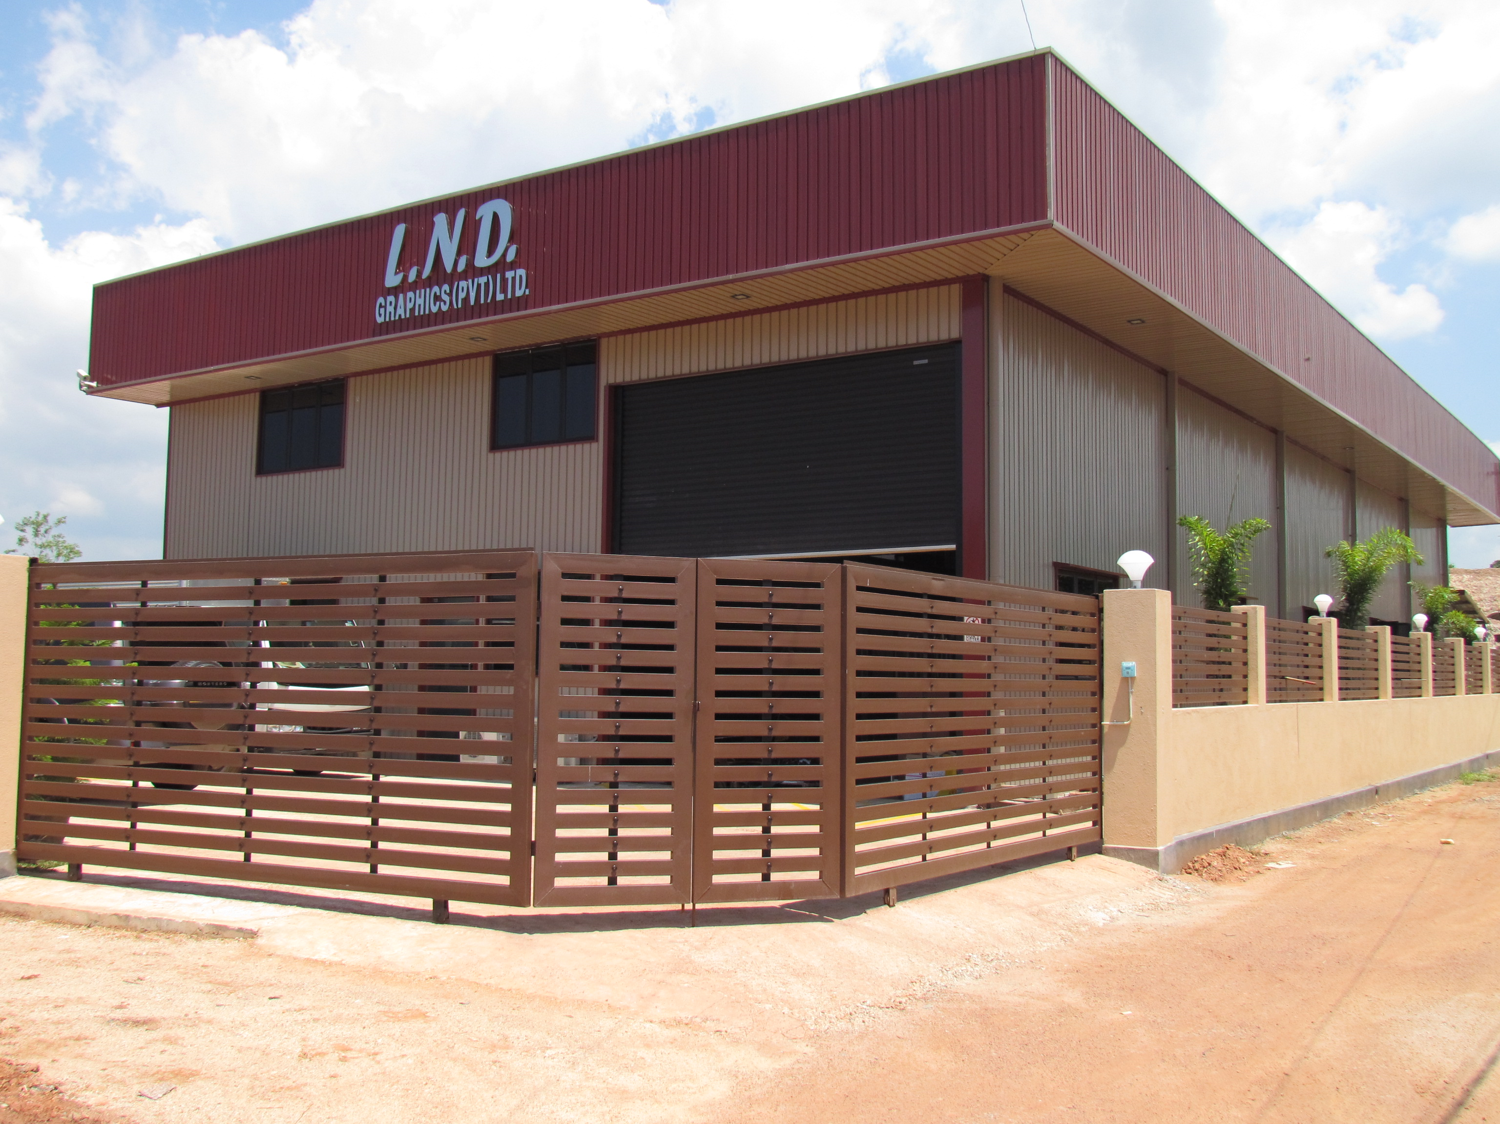

WHY SUCH A SYSTEM ?
Constant complaints from customers for not replying to emails.
Risk of missing important quotation requests.
Incomplete requests where the all details are not mentioned and with different email subjects.
Having issues to be attentive to the customer emails throughout the day.

Slide 3
AIM & OBJECTIVES
Goal is to
create a complete new, automated, user-friendly, quotation generating software to upgrade the organization standards.
By fulfilling :
Observing a new feature makes the new system be better than existing similar soft wares.
Executing a specific algorithm for sorting quotations
Executing an algorithm to create quotations for important and valuable customers.
Creating a special user-friendly GUI to request quotations .

Slide 4
FUNCTIONALITIES
It will make user to work easily with quotations and avoid the previous issues he had to face. Also this system is very organized.
It consists of
A simple web site specifically to request quotations.
All requests will be sent to a particular email address and have a proper subject.
Manager will get notified about a request.
A Database that stores all the prices therefore less time consumption for gathering price details.
Easy way to create the quotations, there’s only few changes to be added for the final quotation.

Slide 5




METHODOLOGY AND TECHNOLOGIES USED
Since the new system will be implemented alongside a working environment. Prototype methodology is used in developing this system.

